Slide 1
EGR 710 Team Project Dr. Soni Fall 2011
Robert Cloud
Mikey Hannon
Suman Silwal
Steve Wingo

Slide 2
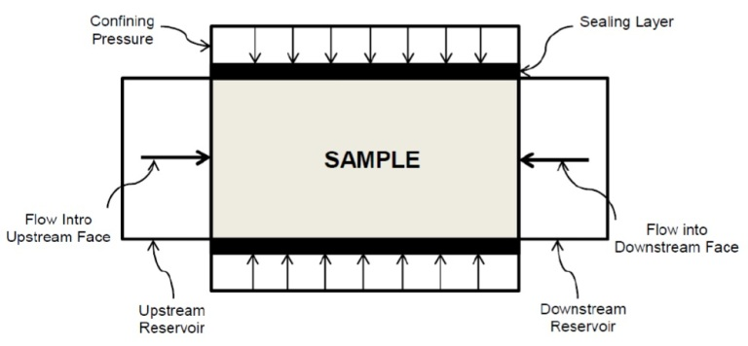
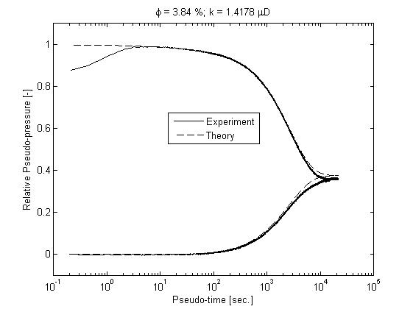
Project Goals
To use an Interdisciplinary Engineering Approach to Leverage the Power of Distributed Computing and to take advantage of the Resources of Cloud Computing for a Computationally Intensive Research Application.

Slide 3
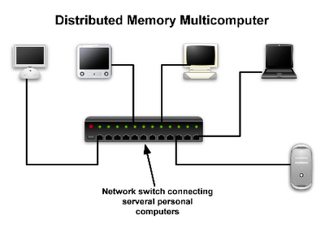
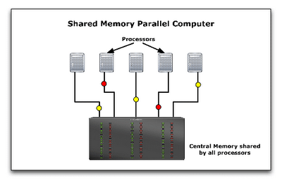
Forces
Processors
Chip Performance Improvement is Slowing
Critical Problems: Capping Power Usage and Heat Generation
Chip Makers Turning to Multi-Core Processors
Distributed Computing
Across Multiple Cores
Across Multiple Systems
Parallel Computing
Distributed Memory Multi-Computer
Shared Memory Multi-Processor
Computational Branch of Science
As an addition to Experimental and Theoretical Science
Images : http://pleasemakeanote.blogspot.com/2008/06/parallel-computing-with-mpi-part-vi.html
Notes:
Jim Gray (born January 12, 1944; lost at sea January 28, 2007) was an American computer scientist who received the Turing Award in 1998 for seminal contributions to database and transaction processing research and technical leadership in system implementation.
Frances E. Allen who received the Turing Award in 2006 for pioneering contributions to the theory and practice of optimizing compiler techniques that laid the foundation for modern optimizing compilers and automatic parallel execution.

Slide 4
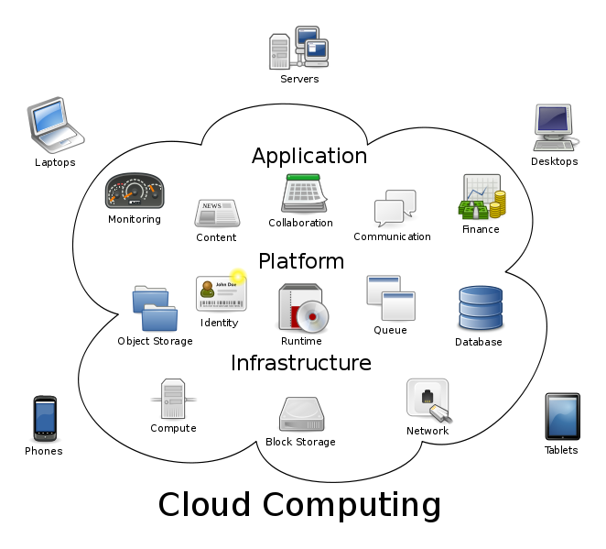
Cloud Computing
Cloud computing is the delivery of computing as a service rather than a product, whereby shared resources, software, and information are provided to computers and other devices as a utility (like the electricity grid) over a network (typically the Internet).

Slide 5
Benefits of Using Cloud Computing
Empowerment of end-users of computing resources by putting the provisioning of those resources in their own control, as opposed to the control of a centralized IT service
Agility improves with users' ability to re-provision technological infrastructure resources.
Cost is claimed to be reduced and in a public cloud delivery model capital expenditure is converted to operational expenditure.
Device and location independence enable users to access systems using a web browser regardless of their location or what device they are using (e.g., PC, mobile phone).
Reliability is improved if multiple redundant sites are used, which makes well-designed cloud computing suitable for business continuity and disaster recovery.
Scalability provisioning of resources on a fine-grained, self-service basis near real-time, without users having to engineer for peak loads
Maintenance of cloud computing applications is easier, because they do not need to be installed on each user's computer

Slide 6
Why Cloud for Computationally Intensive Research?
Traditional High Performance Computing
Data Intensive Calculation
Data Storage
Access and Cost
Control of Data
Cloud Computing
Legal, Regulatory, and Audit
Security
Cost
Slower Interconnections

Slide 7
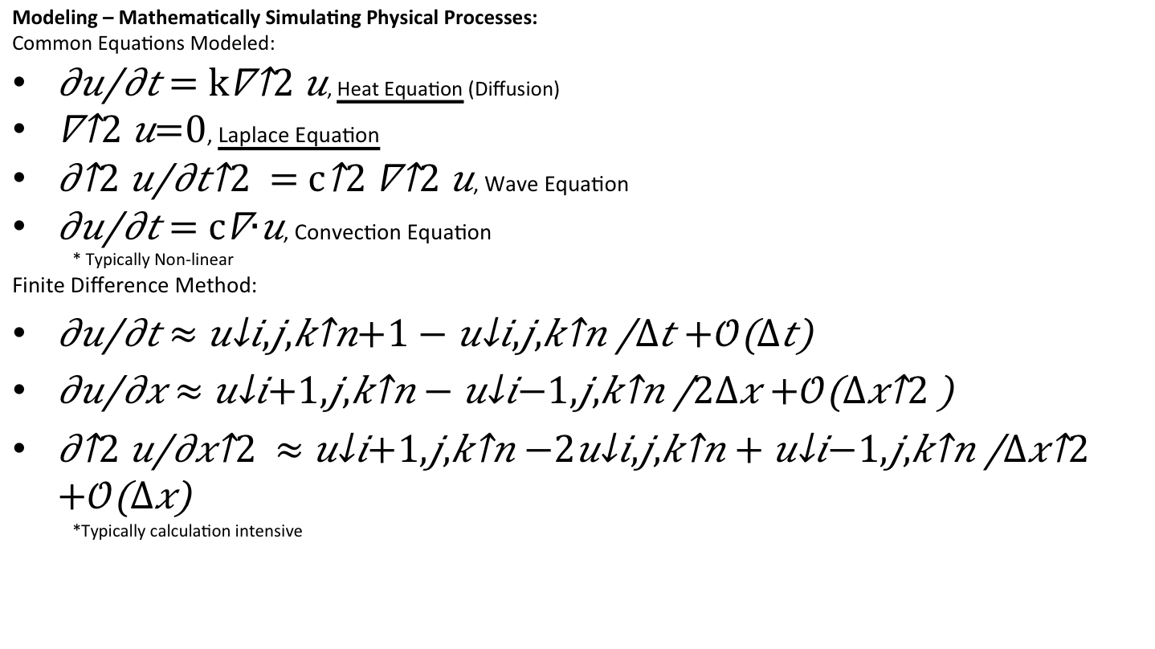
Applications of HPC and Cloud Computing
Modeling – Mathematically Simulating Physical Processes:
Common Equations Modeled:
, Heat Equation (Diffusion)
, Laplace Equation
, Wave Equation
, Convection Equation
* Typically Non-linear
Finite Difference Method:
*Typically calculation intensive

Slide 8
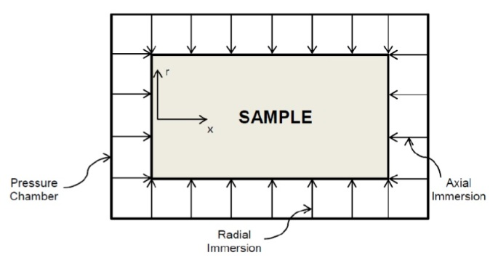
Inverse Modeling – Parameter Identification from a Designed Experiment:
Important physical properties of various systems by a least-squares curve fit of experimental data with respect to the parameters of interest. This requires multiple model calculations to minimize error.
Pressure-pulse decay measurements to determine porosity and absolute permeability of ‘tight’ rocks (1-D heat equation w/published exact solution)
Fully immersed sample to determine permeability parallel and perpendicular to bedding plane (2-D heat equation w/o published exact solution)

Slide 9
Parallelizing Software
OpenCL
Easy to Use
Freely Available
Automatic Scaling as Number of Cores are Increased
MPI
Distributed memory computing
Parallelize code on clusters
Scales to 100,000+ cores
Good Language Bindings
Starcluster:
Mechanism to Create and Manipulate Amazon EC2 Instances as Clusters
Hybrid Computing
Notes:
First, we will look at a characteristic problem that one may deal with in scientific computing. Then we will look at progressive implementations in Python to improve performance.

Slide 10

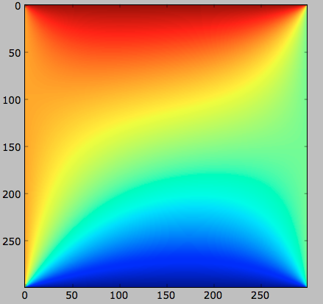



Vectorizing for Higher Performance
Notes:
Python is notorious for being slow when iterating over values. Thus functionality is provided by numpy to overload the universal functions, for instance addition and division, with high performance C code. A fast C loop is used on the backend when we are using this vectorized notation. The slicing notation is familiar to those who use matlab.

Slide 11

Jacobian Iteration
Ideal for Parallelism, next iteration only dependent on previous iteration
Allows for simple domain decomposition
Start with initial approximates of unknown variables(typically 0)
Iterate until the change between steps is less than a specified epsilon
Notes:
Jacobi iteration is simpler and more easy to parallelize than an alternative iteration scheme for instance Gauss Seidel. We start with initial approximations of each unknown variable(each internal point in the grid). Notice that the coefficients of the linear equations are all 0.25.

Slide 12
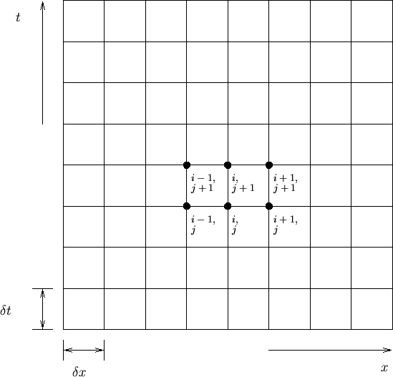
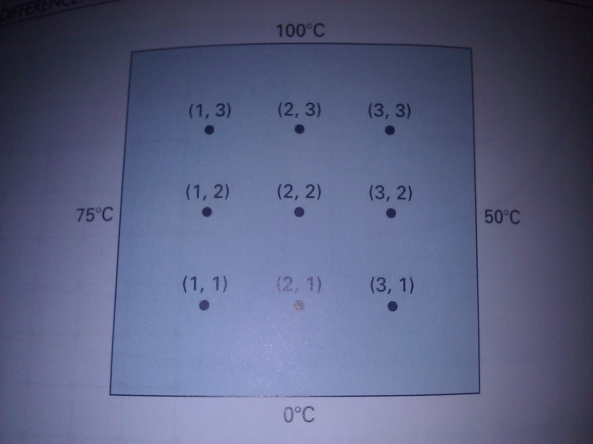
Finite Difference Grid
http://www.me.ucsb.edu/~moehlis/APC591/tutorials/tutorial5/node3.html
When dx,dy are equal:
y
y
Notes:
We arrive at this simple algebraic expression with delta x and delta y are equal. The boundary conditions were pulled from a textbook on numerical methods so that we can check the answer. We discretize the equation in space using a grid.

Slide 13

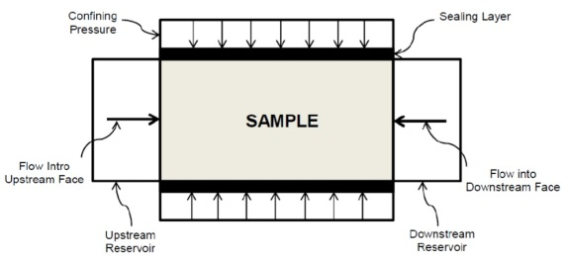
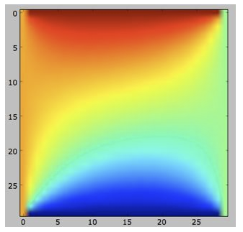

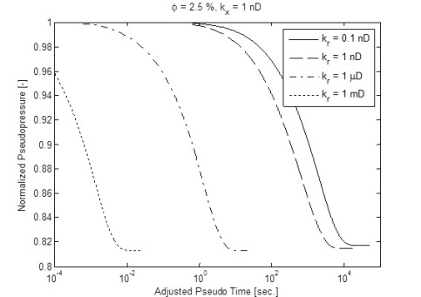
Progress To-Date and Future Work
Progress: Laplace Equation (“Toy Problem”)
Already implemented under various boundary conditions in clusters up to 64 cores.
Work to do:
Translate to Cloud (Amazon EC2)
Compare scaling performance with multicore implementation
Multi-core nodes?
Progress: Pressure-pulse decay
Measurements performed for 1D case
Single-processor model created
for 2D case
Work to do:
Translate to parallel implementation
Translate to Cloud
Create experimental apparatus for 2D case (not necessary for this project)

